Slide 1
Ｇ Ｕ Ｐ Ｓ Ｌ Ａ
Gpu-based User Programmable Sqauare Lattice Automata
El-Saig Dávid
O7H8AE

Slide 2
Ｉｎｔｒｏ
CA – Cellular Automata (many simple finite state machines that only interact with their neighbours) SLA – Square Lattice Automata (CA on a 2D array)
Let's make some SLA models and visualise them as animation!

Slide 3
Ｐｒｏｊｅｃｔ Ｇｏａｌｓ
Toolkit for building CA simulations
CLI visualisation generator
Sample CA models

Slide 4
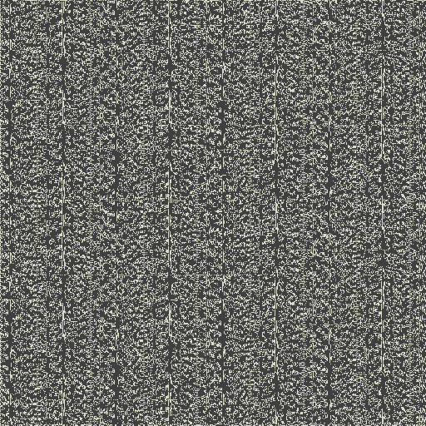
Ｓｏ．．． ｗｈａｔ ｃａｎ Ｉ ｅｘｐｅｃｔ？
Large GIFs like this.

Slide 5
Ｔｈｅ Ａｐｐｌｉｃａｔｉｏｎ
That was gupsla-gif in action
A plain Visual C++ project to connect
The user via command line flags
The CUDA project gupsla
Lecram’s gifenc C library
Of course #2 is the star of the show

Slide 6
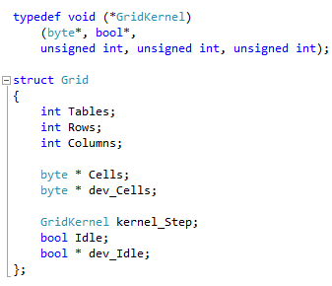
Ｔｈｅ Ｌｉｂｒａｒｙ
Made of several CU, H and CUH files
H: public API for non-CUDA
CUH: CUDA-based extension interface
grid.cu: Grid struct, it’s methods/kernels

Slide 7
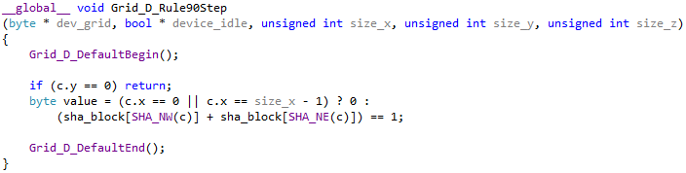
Ｉｍｐｌｅｍｅｎｔａｔｉｏｎ
Grid_Create: allocate table on host and device
Grid_Step: prepare and launch grid->kernel_Step
kernel_Step
Contains the step logic
Written by the library user
The macros and __forceinline__ functions in grid.cuh do all of the groundwork so it’s very short.

Slide 8
Ｓｍａｌｌ Ｓｔｅｐｓ
Each cell is processed separately (no loops)
Sqare blocks
Block size and size of sha_block depends on available shared memory (cudaGetDeviceProperties)
sha_block: cells in block + Moore neighbourhood
Helpers inside kernel_Step
Calculate coordinates and sizes
Fill in sha_block
Update detection

Slide 9
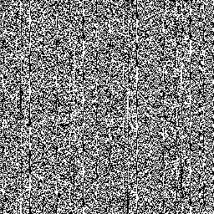
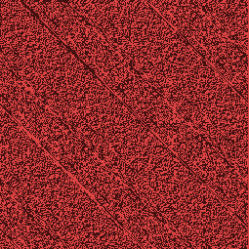

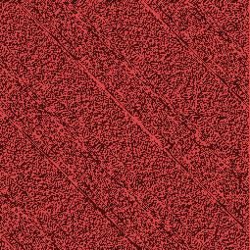
Ｉ ❤ ｍａｃｒｏｓ
2D arrays are hard to follow
it gets worse if you embed them into each other
So I rewrote the
whole thing with
a lot of macro use
to re-label everything...
My eyes!
I just wanted some diagonal lines...

Slide 10
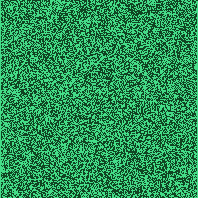
Much better!

